Slide 1



Slide 2

UNIT 6: MONEY
READING
AARON LEVIE

Slide 3
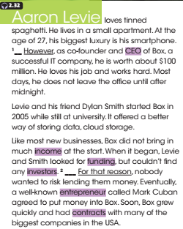



Slide 4
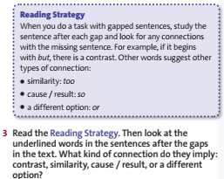


Slide 5
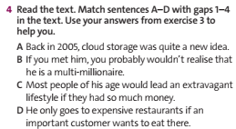




Slide 6
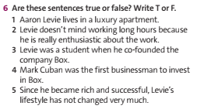
B
A
C
D

Slide 7
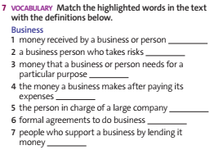

B
A
C
D

Slide 8
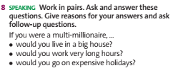

Slide 9

1/ Learn by heart all new vocabulary, phrases, and structures.
2/ Prepare for the next lesson.

Slide 10
THANK YOU
FOR YOUR ATTENTION

